Slide 1




Team 4 members: Gina Villegas Jason XINGCHI Zhang Matt Janousek
Enabled by a Joint Operation of
WELCOME TO PROJECT: DR. ME

Slide 2
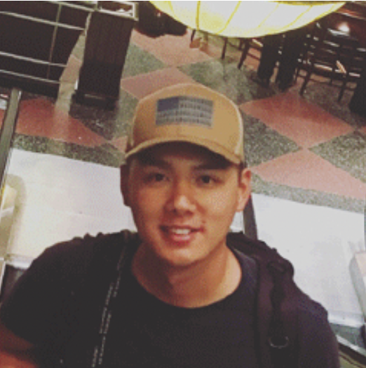
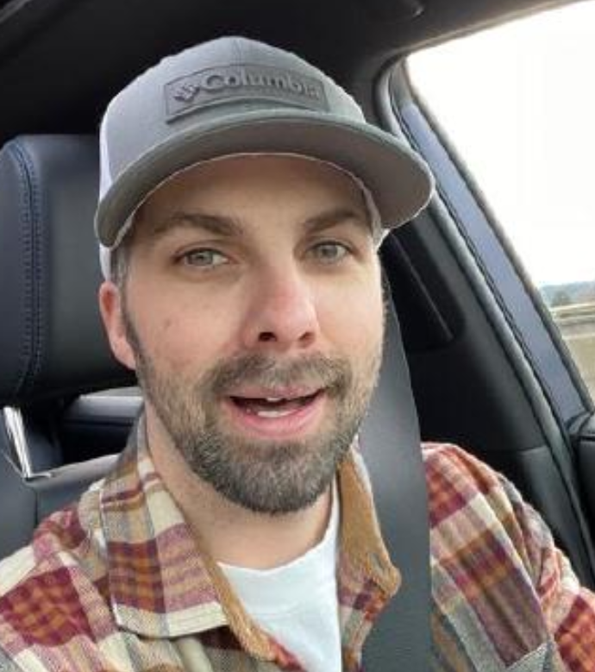
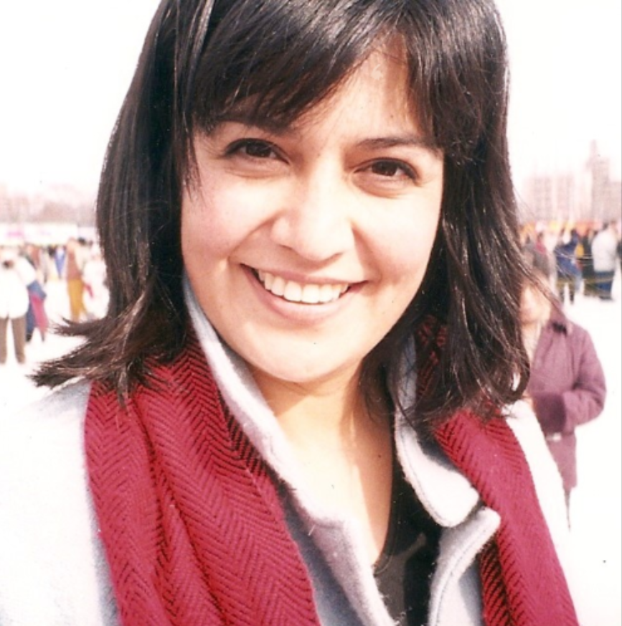
Meet the team
Jason Xingchi Zhang - Amazon military apprentice
Matt Janousek - Amazon military apprentice
Gina Villegas - Amazon military apprentice

Slide 3

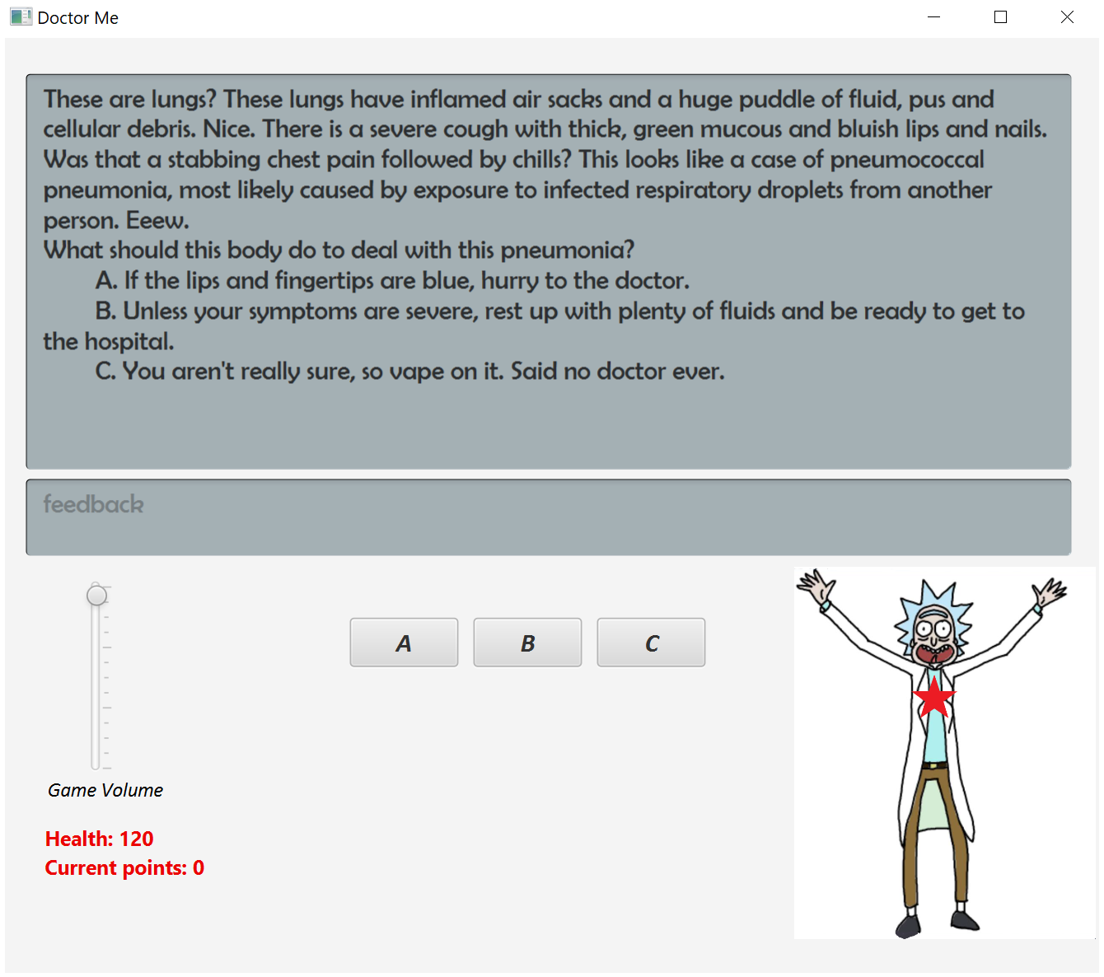
Dr. Me is a java-based game featuring javafx graphics. It was created implementing agile methodology.
Let’s Dive In

Slide 4
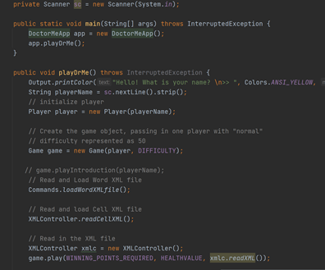
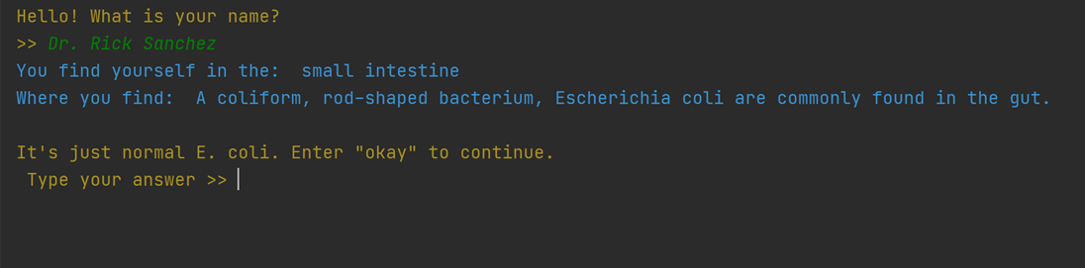
Where we began
- The only thing we know about the project is that it is supposed to be a text-based game.
- We take over the console version of the game from another team without knowing how it works what it does.
- We clone the repo and run the code to learn what is does and understand how it works.
- Meanwhile, communicate to understand and get to know each team member.
- As a team, We brainstorm on the next steps, e.g., features to develop, selection of tech stacks, feasibility study.

Slide 5
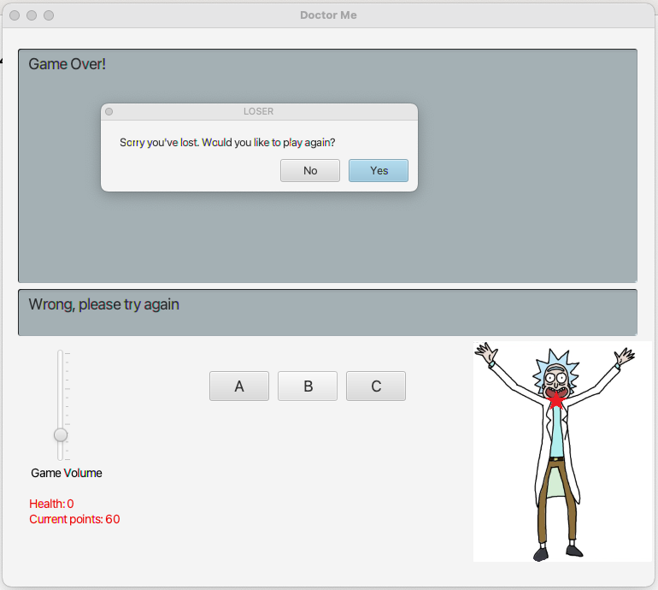
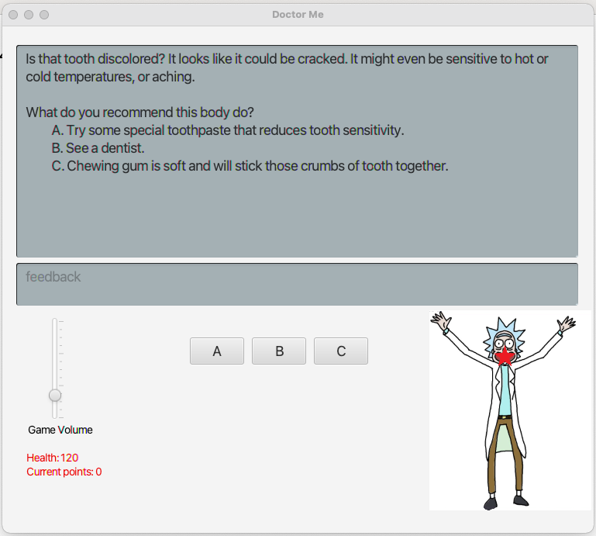
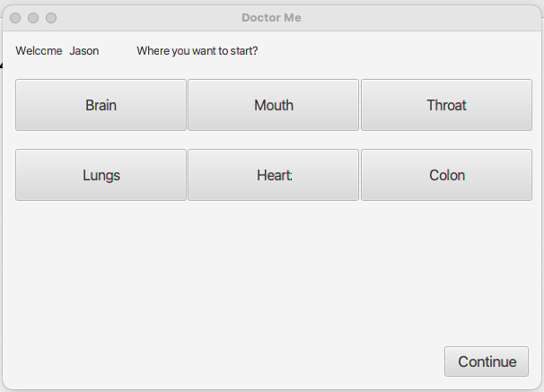
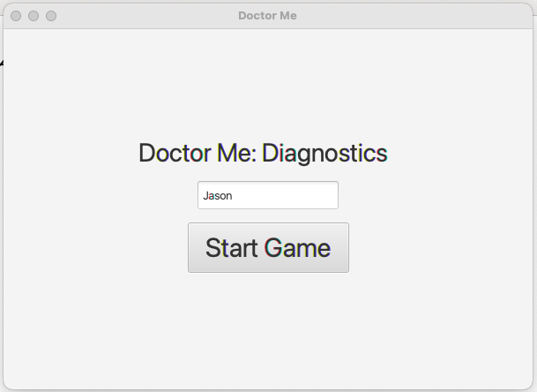
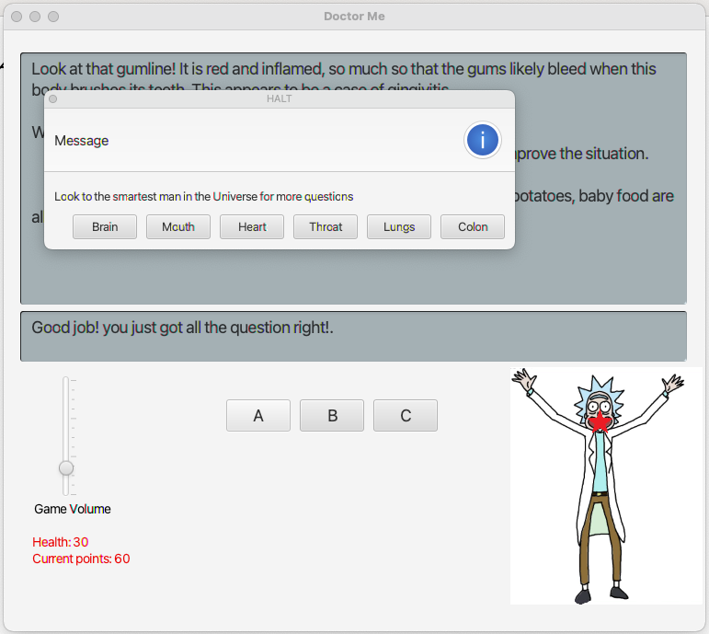
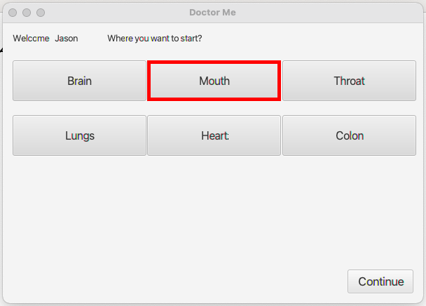
Where we ENDUP
(1/3)
- We understand what the legacy code base does and how it works by leverage debugger.
- We have solid understanding of Agile software development.
- We adopted JavaFX an open-source next generation client application platform for desktop, mobile and embedded systems built on Java.
- We extend features such as traverse the body, added music and volume control, visual representation of current location.
- We have executable jar release for both Windows OS and MacOS.

Slide 6
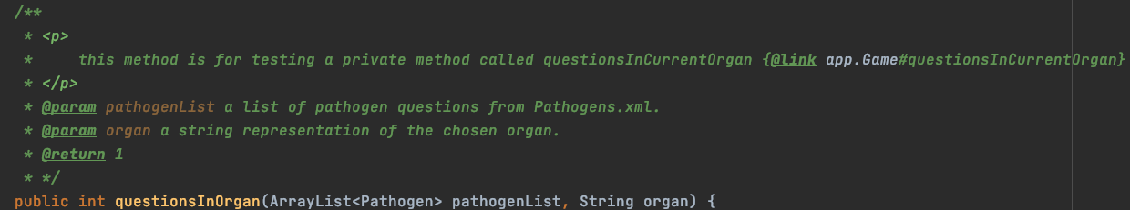
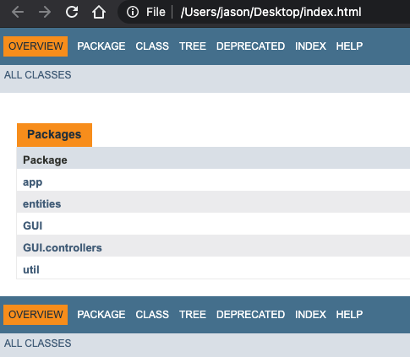

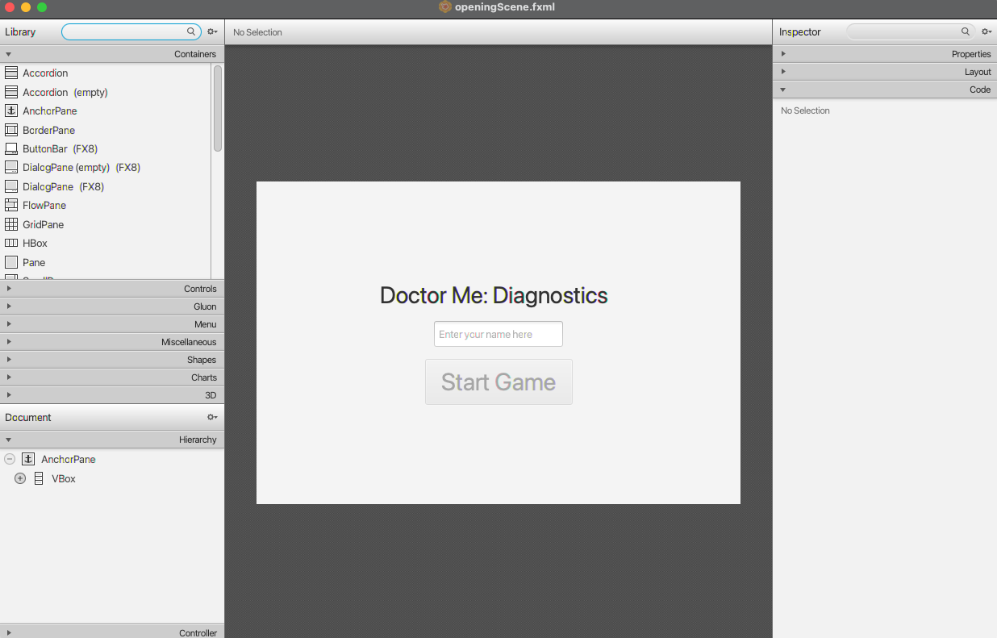
Where we ENDUP(2/3)
- We wrote extensive comments and generated Javadoc.
- We have solid understanding of Agile software development.
- We adopted JavaFX an open-source next generation client application
platform for desktop, mobile and embedded systems built on Java. And its intuitive way of structure GUI with SceneBuilder and XML.
- Follow MVP model-view-controller singleton Design Pattern.
- We extend features such as traverse the body, added music and volume control, visual representation of current location.
- We have executable jar release for both Windows OS and MacOS.
- We learn a new technology JavaFX.
Page 2 of 2

Slide 7
Where we ENDUP(3/3)
- We take calculated risk to learn JavaFX instead of take off with java swing.
- We grasp the theory of Agile, so we can delivery feature in a timely manner.
- We work backwards as a team, we walk in customer's shoe
-

Slide 8
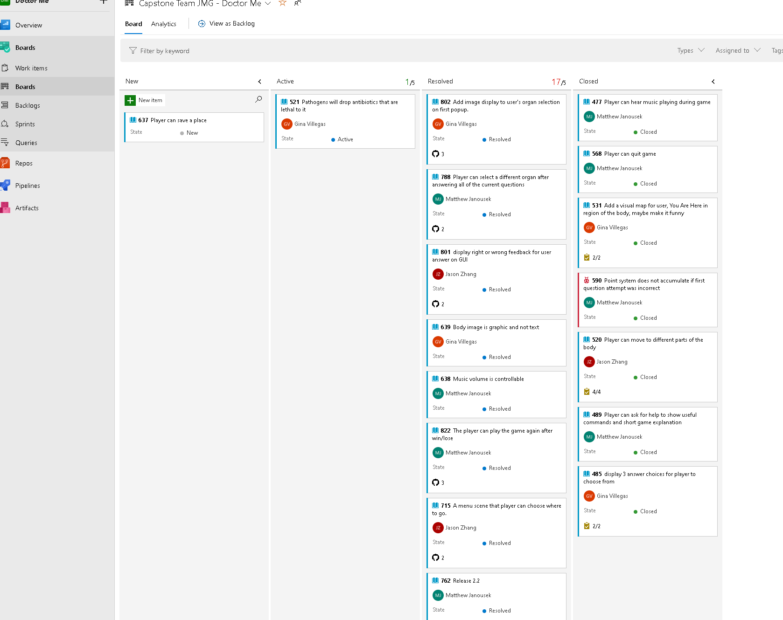
Kanban
What is DevOps
Agile development
Spring
User story
Associate branch with ticket number
Backlog

Slide 9
Jason
- pair programming and work in team environment.
- name variable and method with meaningful name.
- keep method small and just do one thing.
- leverage debugger to track down bug /understand code wrote by others.
- Not only how but why it's important to master Data Structure and Design Pattern.
- Systematic troubleshooting.
- writing comments is an enjoyment.
- open-source projects are a great starting point.

Slide 10
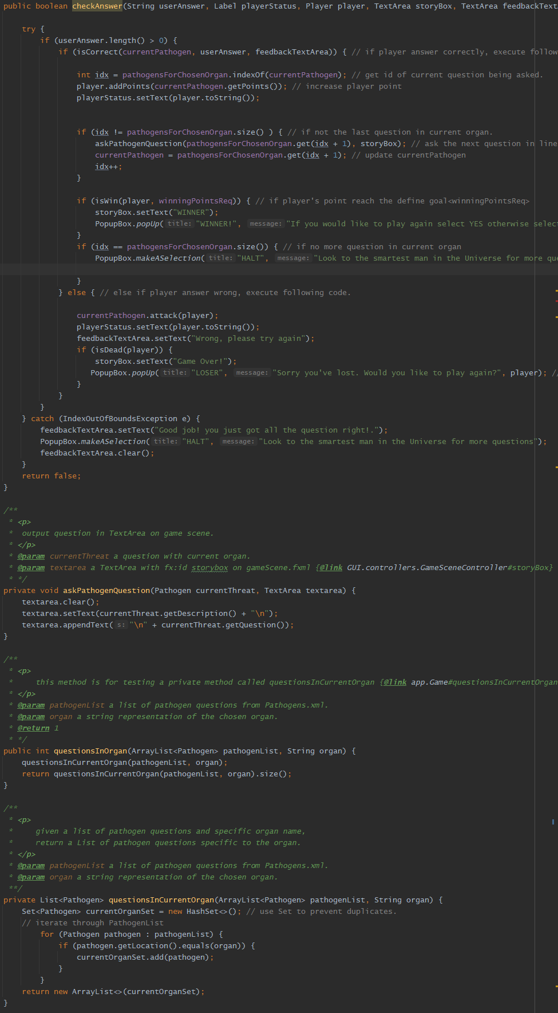
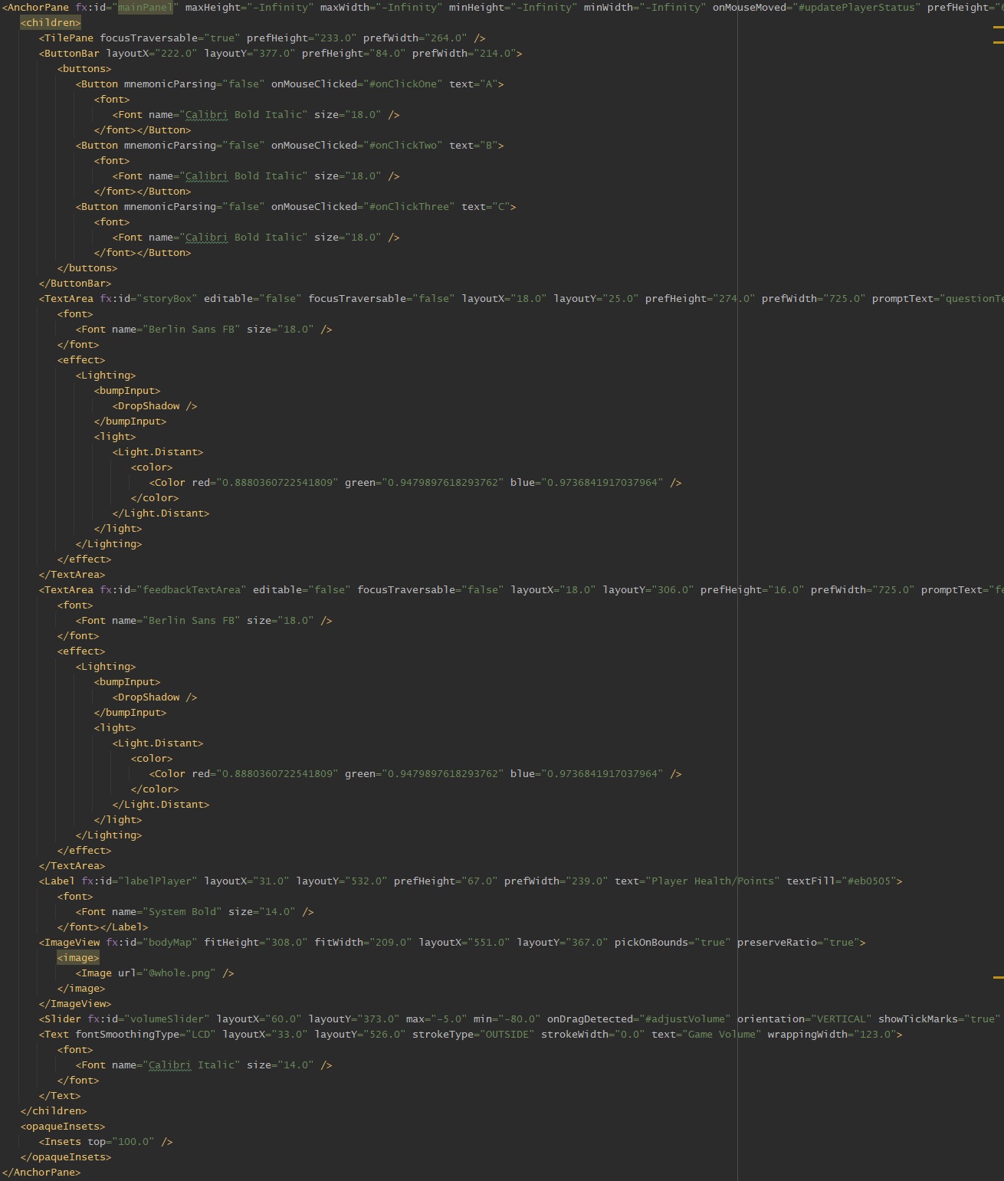
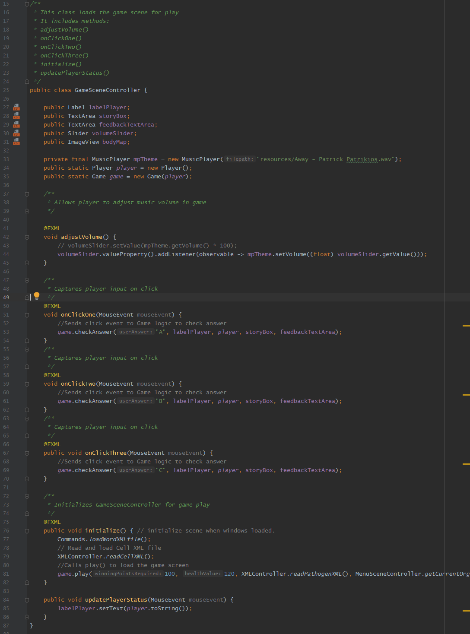
Matt

Slide 11
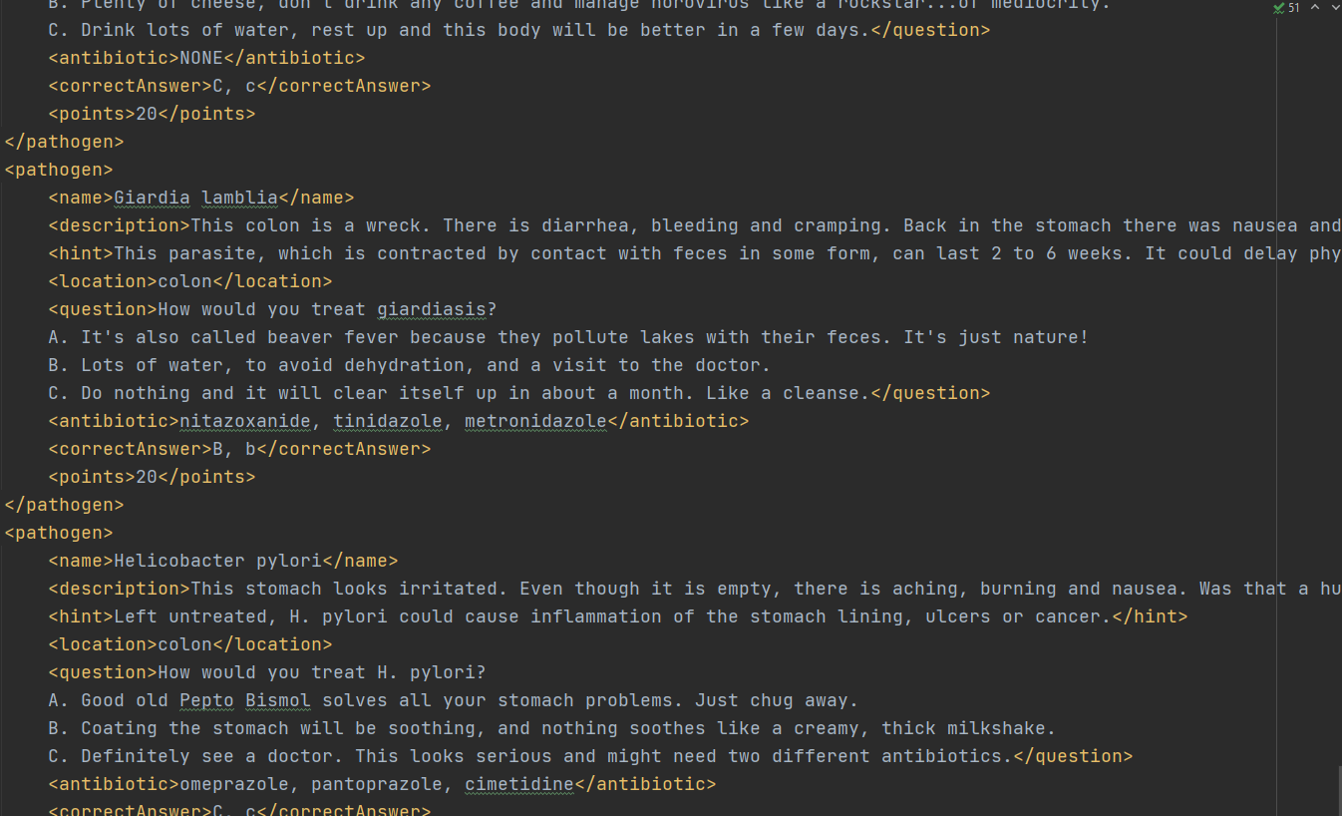
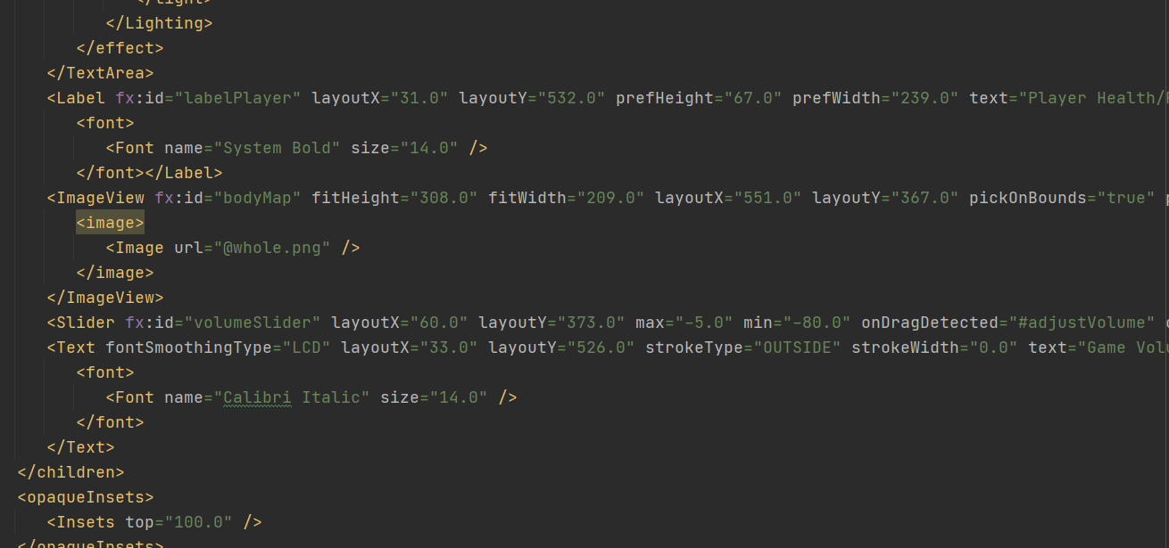
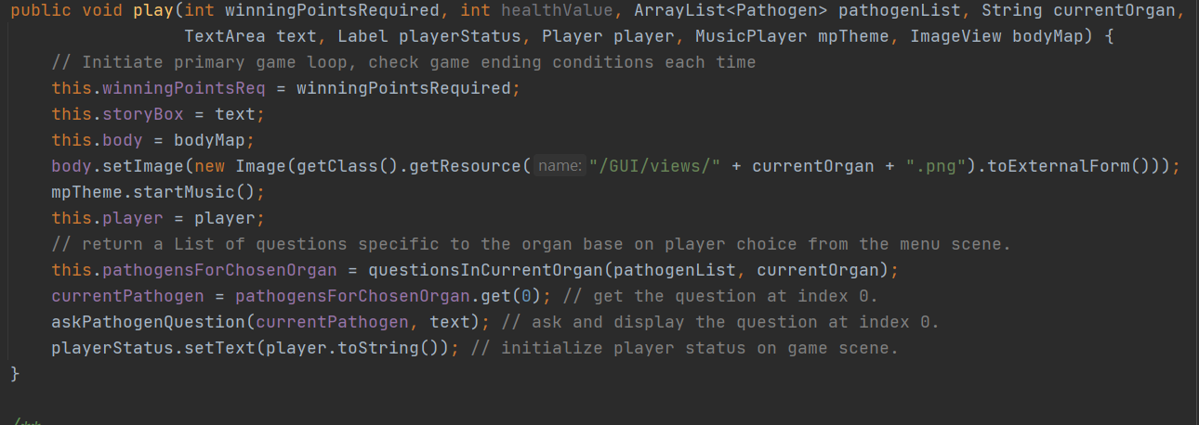
gina

Slide 12
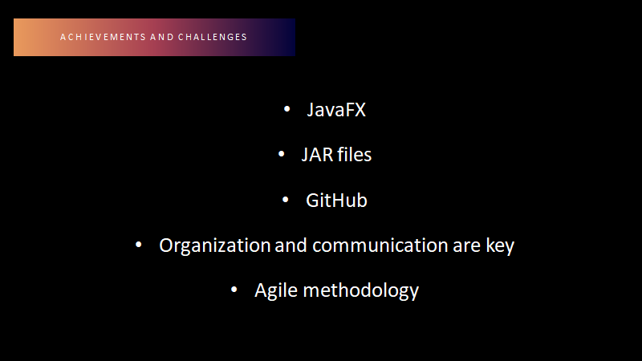

Slide 13

Future Goals
Create Responsive version
Make it available in all app stores
Market to Adult Swim Channel

